Slide 1
Analog Electronics Lab Experiment-8
Instructors name:
P3:
Ashish Kumar Varma
Sambhavi Shukla
P4:
Ankita Dixit
Premsai Regalla

Slide 2
Sinusoidal and Non-sinusoidal Oscillators

Slide 3
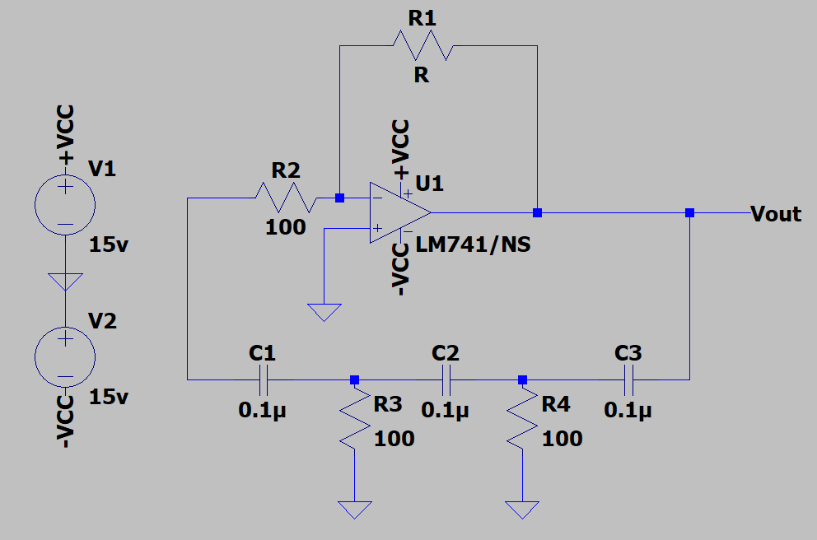
(a) RC Phase shift Oscillator

Slide 4
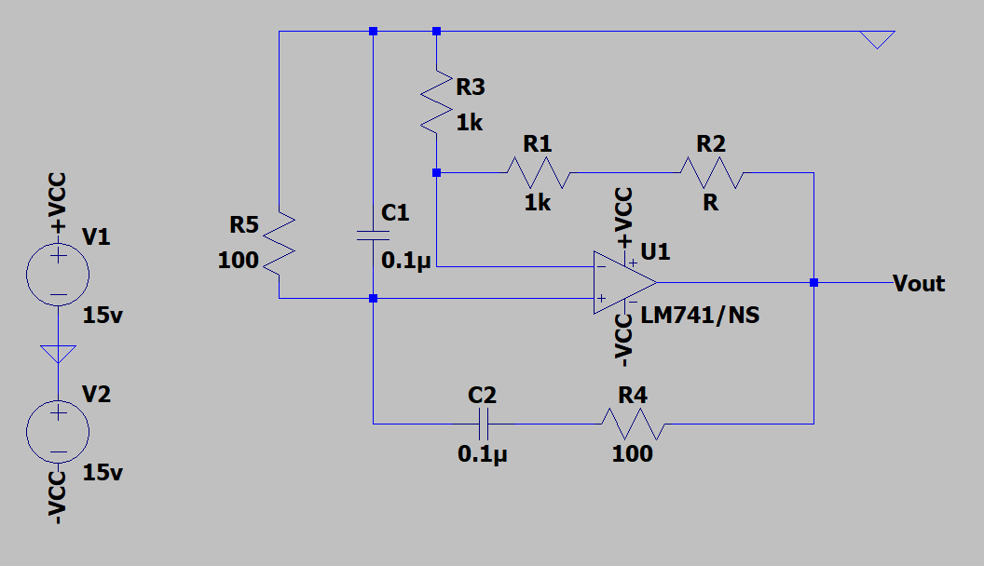
(b) Wein Bridge Oscillator

Slide 5
Assignment:
To study the sinusoidal and non-sinusoidal oscillators
1) RC Phase Shift Oscillator
2) Wein Bridge Oscillator
Upload a single PDF file on Nalanda which includes
1) Circuit diagrams for both configurations.
2) Output waveforms
3)Compare your theoretical values with the practical ones.
Submit the report in a single PDF format (file name should be your ID) on Nalanda within 48 hrs., after your lab section. (2 marks deduction for late submission) Personal submission on email will not be considered.

